Slide 1


Mitron Bank
Credit Card Market Analysis for Product Strategy
By Pankaj Modi

Slide 2
Agenda
Introduction
Problem Statement
DashBoard Overview
Key Insights
Credit Card Recommendation

Slide 3


Introduction
Mitron Bank is a legacy financial institution headquartered in Hyderabad.
AtliQ Technologies is a one-stop shop for businesses looking to grow. They combine data analysis, AI, and app development to craft winning strategies and drive results. With a 70% client success rate, they're experts in transforming businesses and igniting growth.

Slide 4


Problem Statement
Mitron Bank is a legacy financial institution headquartered in Hyderabad. They want to introduce a new line of credit cards, aiming to broaden its product offerings and reach in the financial market.
Peter Pandey, employed as a data analyst at AtliQ Data Services, has been assigned a project by his supervisor. His task involves examining the given sample data and presenting significant insights to Mitron Bank's strategy team.
The objective is to generate insights through a self-explanatory and easily understandable dashboard, aiming to assist the team in tailoring credit card offerings according to customer needs and current market trends.

Slide 5

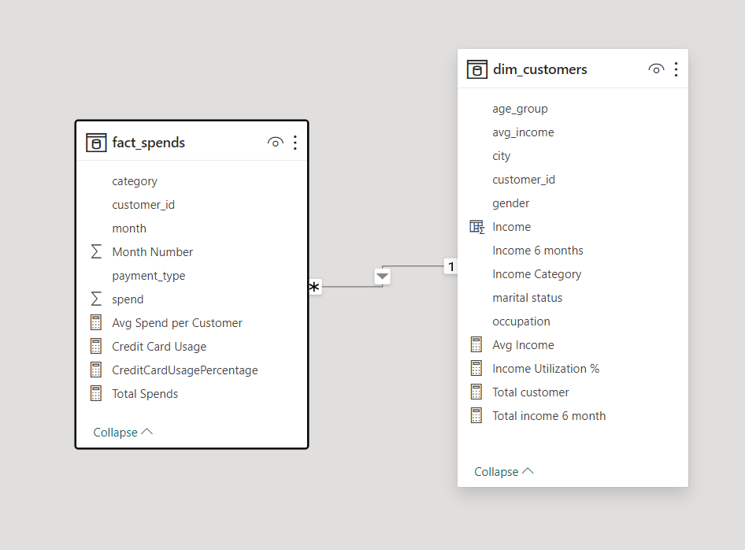
Dataset of Mitron Bank
4000 Customers

Slide 6
Dataset Details
Gender: Male, Female
Age Group: 21-24, 25-34, 35-45, 45+
Marital Status: Single, Married
City: Mumbai, Delhi-NCR, Chennai, Hyderabad, Bengaluru
Occupation: Salaried IT Employees, Salaried Other Employees, Business Owners, Freelancers, Government Employees
Month: May, June, July, August, September, October
Category: Apparel, Bills, Electronics, Entertainment, Food, Groceries, Health & Wellness, Travels, Others
Payment type: Debit Card, Credit Card, UPI, Net Banking

Slide 7
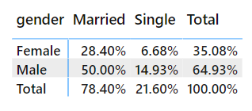
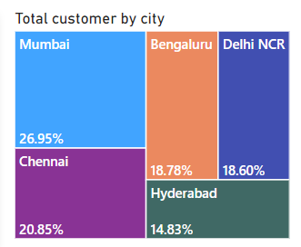
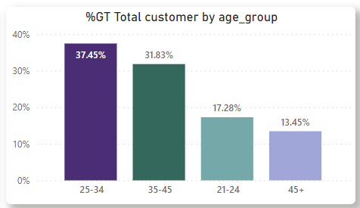
Insights
Demographic Analysis
This is the count of customers based on Gender and their Marital Status.
35.08% customers are Female,
64.93% customers are Male,
78.40% customers are Married,
21.06 customers are Single

Slide 8
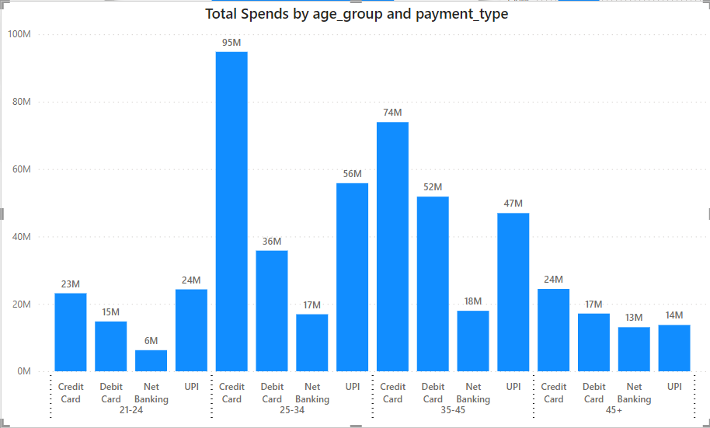

Spending Insights:
Insights:
Age group(25-34) are spending more than any other age group customers followed by 35-45 age group customers.
In both 25-34 and 35-45 age group customers are spending using credit card followed by UPI payments.

Slide 9
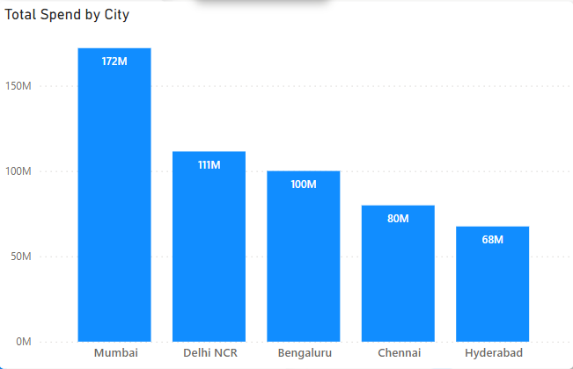
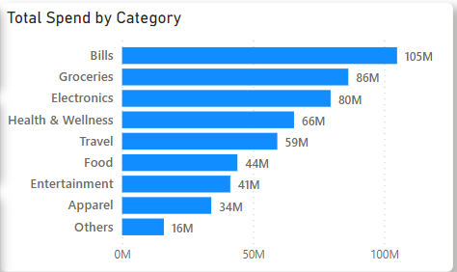
Spending Insights:
Insights:
Customer from Mumbai location are spending more and then 2nd highest spending city is Delhi NCR and then Bengaluru
Insights:
Customer are spending their money on paying bills, Groceries, Electronics, Health & wellness and Travels.

Slide 10

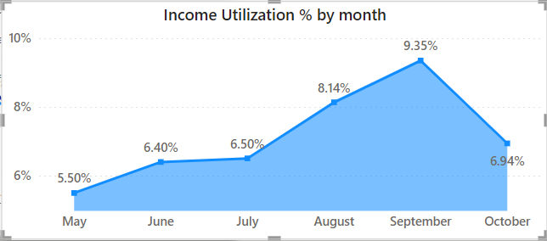
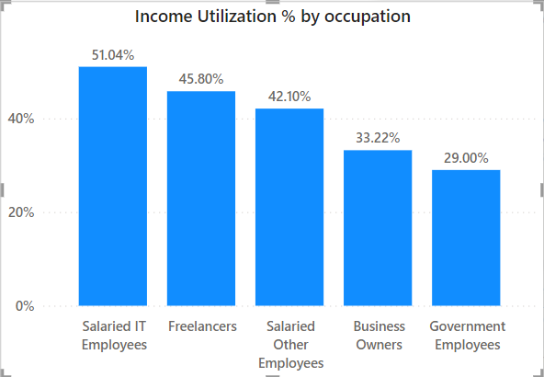
Income Utilization
Income Utilization % = (Total Spends/Total Income)*100
Insights:
1. The highest point is in September with an income utilization of 9.35% followed by August with 8.14%, and then October with 6.94%.
2. The lowest point was in May with an income utilization of 5.50%
1. Utilization Percentage is high by the ‘Salaried IT Employees’ followed by ‘Freelancers’.

Slide 11
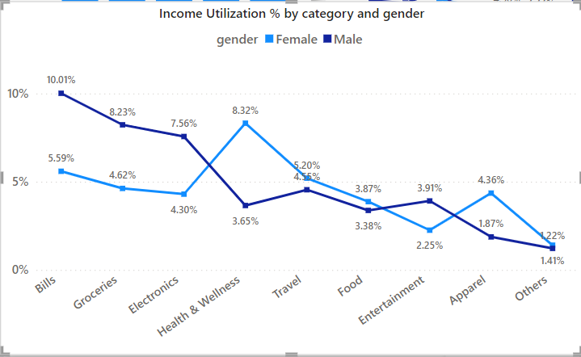
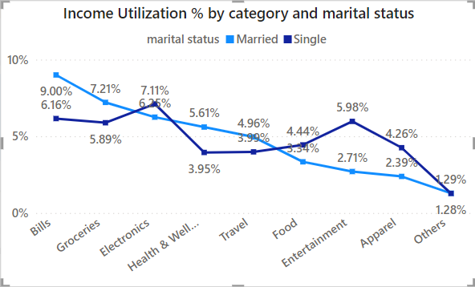
Income Utilization
Insights:
Utilization by male is high for categories like Bills, Groceries, Electronics
While utilization by female is high for categories like Health & wellness, Apparel
Insights:
Utilization by Married customer is high for categories like Bills, Groceries, Electronics
While utilization by female is high for categories like Health & wellness, Apparel

Slide 12
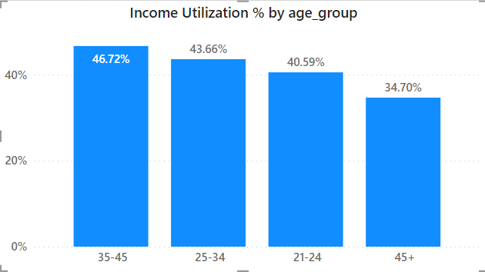
Income Utilization
Insights:
The 35-45 age group has the highest income utilization at 46.72%, followed by the 25-34 age group at 43.66%. The 21-24 and 45+ age groups have lower percentages.
Suggestion:
Income utilization varies significantly with age, with middle-aged individuals utilizing a higher percentage of their income.

Slide 13
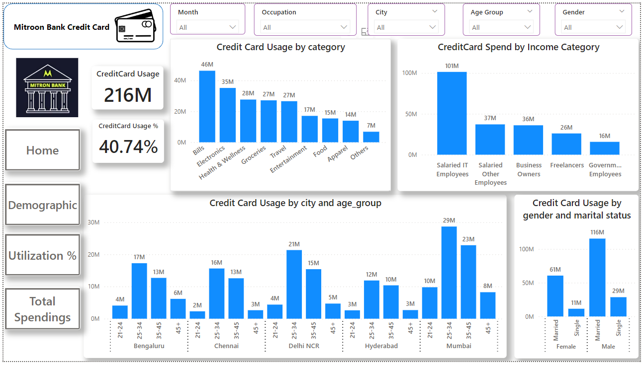
Credit Card Analysis

Slide 14
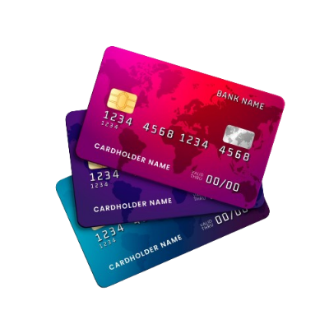
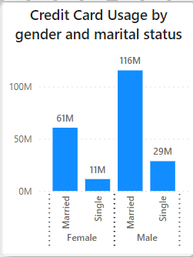

Credit Card Insights
Insights:
Comparing both Gender and Marital status
Married males have the highest credit card usage at 116M, followed by married females at 61M. Single males and females have significantly lower usage at 29M and 11M respectively.
Suggestion:
Married individuals tend to use credit cards more than single individuals, and among them, males use it more than females.

Slide 15

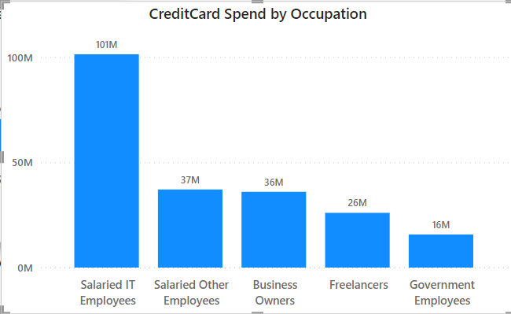
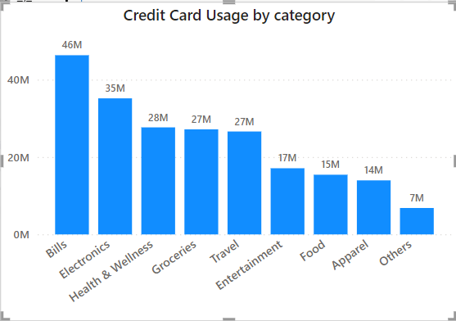
Credit Card Insights
Insights:
Salaried IT Employees have the highest credit card spend at 101M. Salaried Other Employees and Business Owners have similar spends at 37M and 36M respectively.
Suggestion:
Occupation significantly influences credit card spending, with IT professionals spending the most.
Insights:
The highest expenditure is on bills at 46M, followed by electronics at 35M and health & wellness at 28M. Suggestion:
Essential expenses like bills, Electronics, health & wellness and groceries constitute a significant portion of credit card usage.

Slide 16
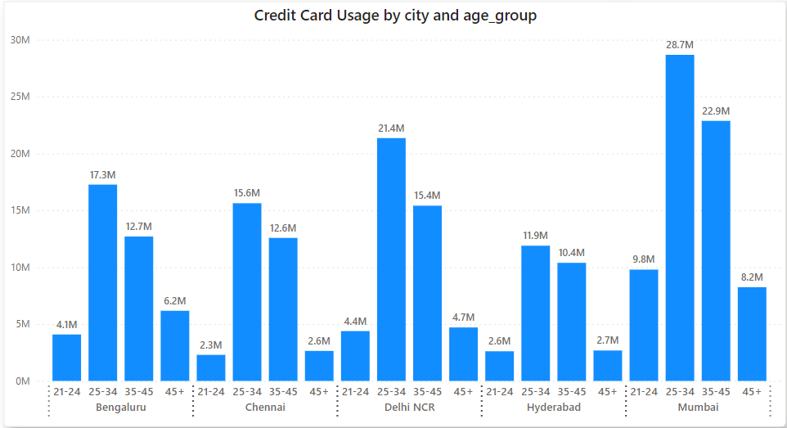
Credit Card Insights
City and Age-Based Usage: Insights:
Mumbai has the highest credit card usage across all age groups.
Bengaluru and Delhi NCR have similar patterns of usage with the 25-34 age group using credit cards the most.
Chennai has the lowest credit card usage among the five cities across all age groups.

Slide 17
Credit Card Recommendation
Location Based Recommendation:
Across all 5 cities, the predominant age groups utilizing credit cards are those between 25-34 and 35-45 years.
Notably, in metropolitan areas, Mumbai and Delhi NCR stand out for their significant credit card expenditures.
In light of this data-driven insight, it would be prudent for Mitron Bank to tailor offerings for these age demographics, focusing on categories such as bills, groceries, electronics, and health & wellness.
Occupation Based Recommendation:
Offers should be extended to both IT professionals and other salaried employees, focusing on categories like bills, electronics, and health.
Additionally, targeting business owners with specialized bill-related offers would be advantageous.
Targeting business owners with bill-related offers can enhance loyalty, streamline their financial management, and boost transaction volumes for Mitron Bank, positioning it as a preferred financial partner for this segment.
Category Based Recommendation:
Providing offers on bills, electronics, and health & wellness across various occupations can stimulate credit card usage, given these are high-spending categories.
Additionally, offering travel incentives across cities can further promote credit card utilization.

Slide 18
Credit Card Recommendation
Age Group based recommendation
For 21-24 age groups, the total expenditure amounts to 24 million via UPI and 23 million through Credit Cards. Given the spending behaviour of this age demographic using UPI, there's an opportunity to transition them towards utilizing Virtual Credit Cards. Therefore, it would be advantageous for Mitron Bank to introduce Virtual Credit Card offerings tailored to these younger customers.
For 45+ age groups, Mitron Bank can strategically position itself by introducing specialized offers focused on health & wellness, and travel.
Marital status based recommendation:
Mitron Bank should roll out offers on groceries, travel, apparel, and entertainment tailored for married customers.
For single customers, Mitron Bank should introduce promotions centred around entertainment, apparel, and travel.
Gender based recommendation:
Mitron Bank should target male customers, as both married and single males demonstrate higher spending compared to females. Offers should be tailored across categories such as bills and groceries.

